Slide 1
VR Controlled Robot
Prototype
Team Members: Eric Hinds, Levi McAdams, Zijian Song, Samuel Torres, and Tyler Allen

Slide 2
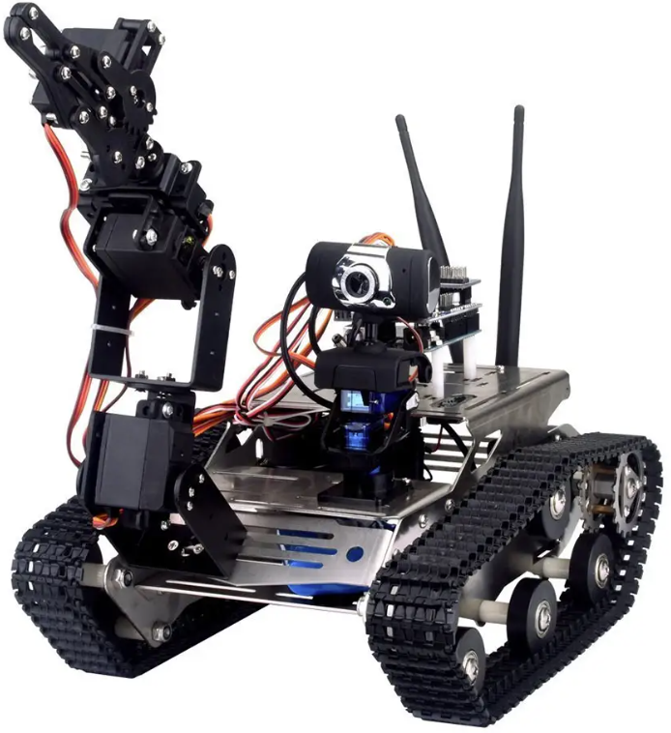
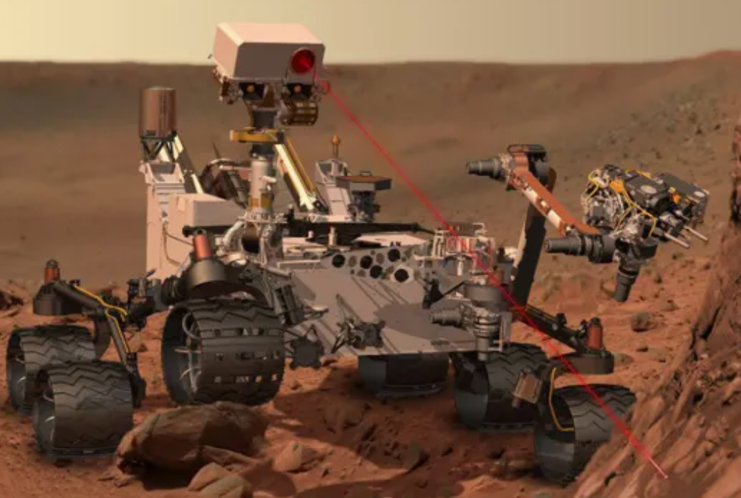
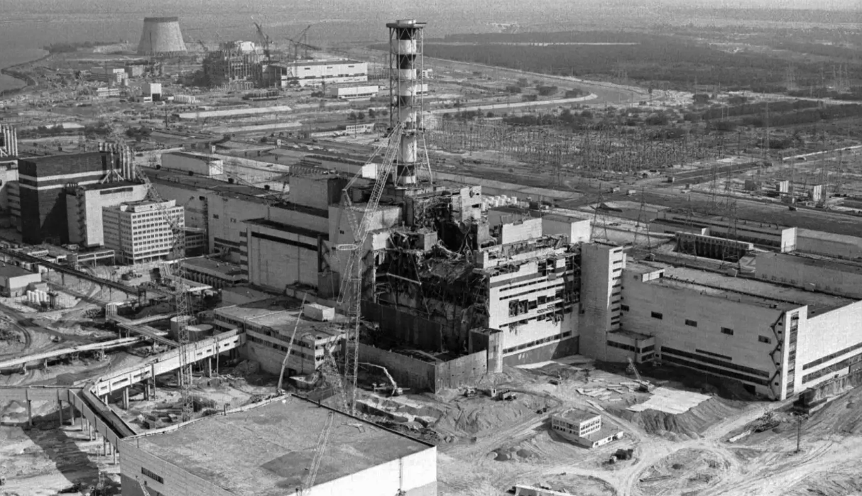
Project Description
VR Controlled Robot(VRCR)
Remote Operation
Exploration
Rescuing under hazardous environments
Assistance of ADS patient or disabled
Figure 1: Robot tank with arm
Figure 2: Robot on Mars
https://www.alibaba.com/product-detail/Unfinished-Smart-Robotic-Car-Kit-A1_62455826527.html
https://www.aljazeera.com/opinions/2012/8/5/curiosity-will-spearhead-new-understandings-of-mars
Figure 3: Chernobyl Nuclear error
Eric Hinds 08/01/23 VRCR
https://www.wwno.org/2021-04-30/chernobyl-first-responder-reflects-on-lessons-learned-35-years-after-explosion

Slide 3

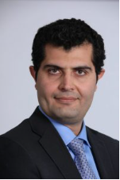
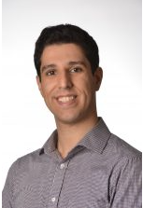
Project Clients
Clients are Dr. Armin and Dr. Reza both from the Department of Mechanical Engineering at NAU
Founding supported by CEIAS
Figure 4: CEIAS
Figure 5: Dr. Armin Eilaghi
Figure 6: Dr. Reza Razavian
Eric Hinds 08/01/23 VRCR

Slide 4
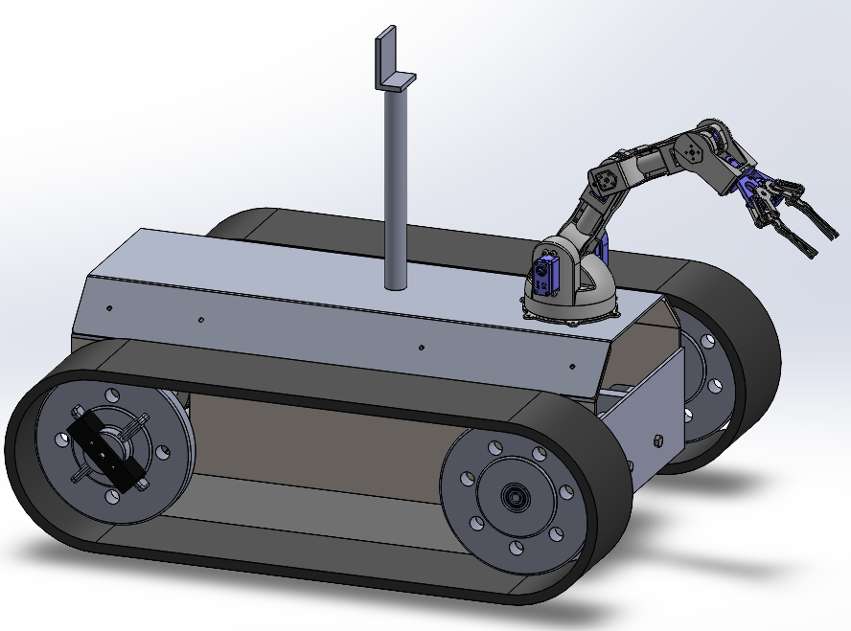
Prototyping Overview
Three Main Subsystems
1. R.U.T. (Robot Utility Tank)
2. Camera/VR Implementation
3. Robotic Arm
Figure 7:CAD Model
Tyler Allen 08/01/23 VRCR

Slide 5
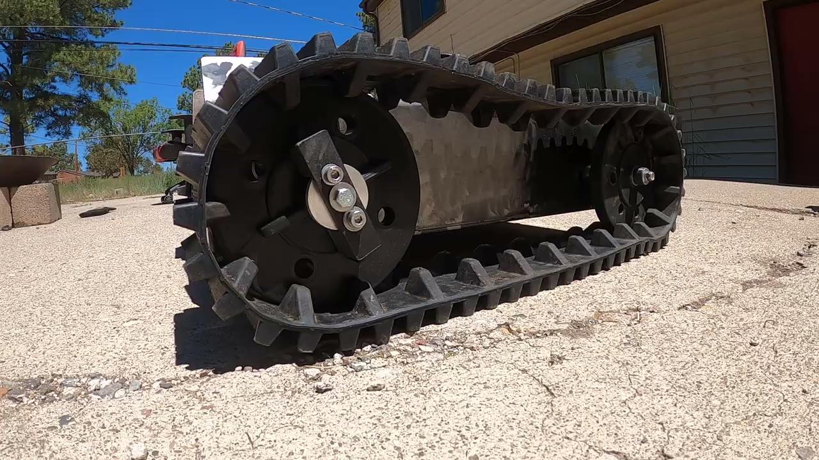
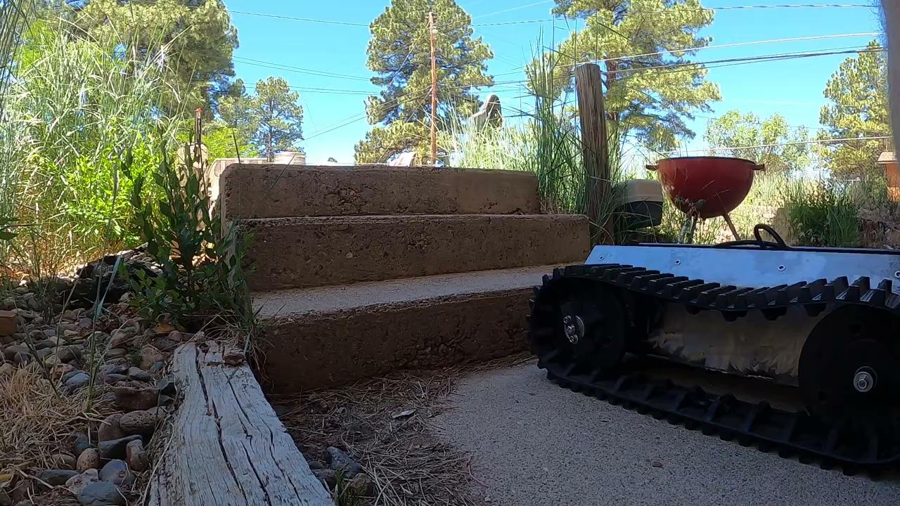
R.U.T. Mobility
R.U.T. Cannot Turn
R.U.T. Cannot Climb Obstacles
Video 1: Turning Fail
Video 2: Obstacle Fail
Levi McAdams 08/01/23 VRCR

Slide 6
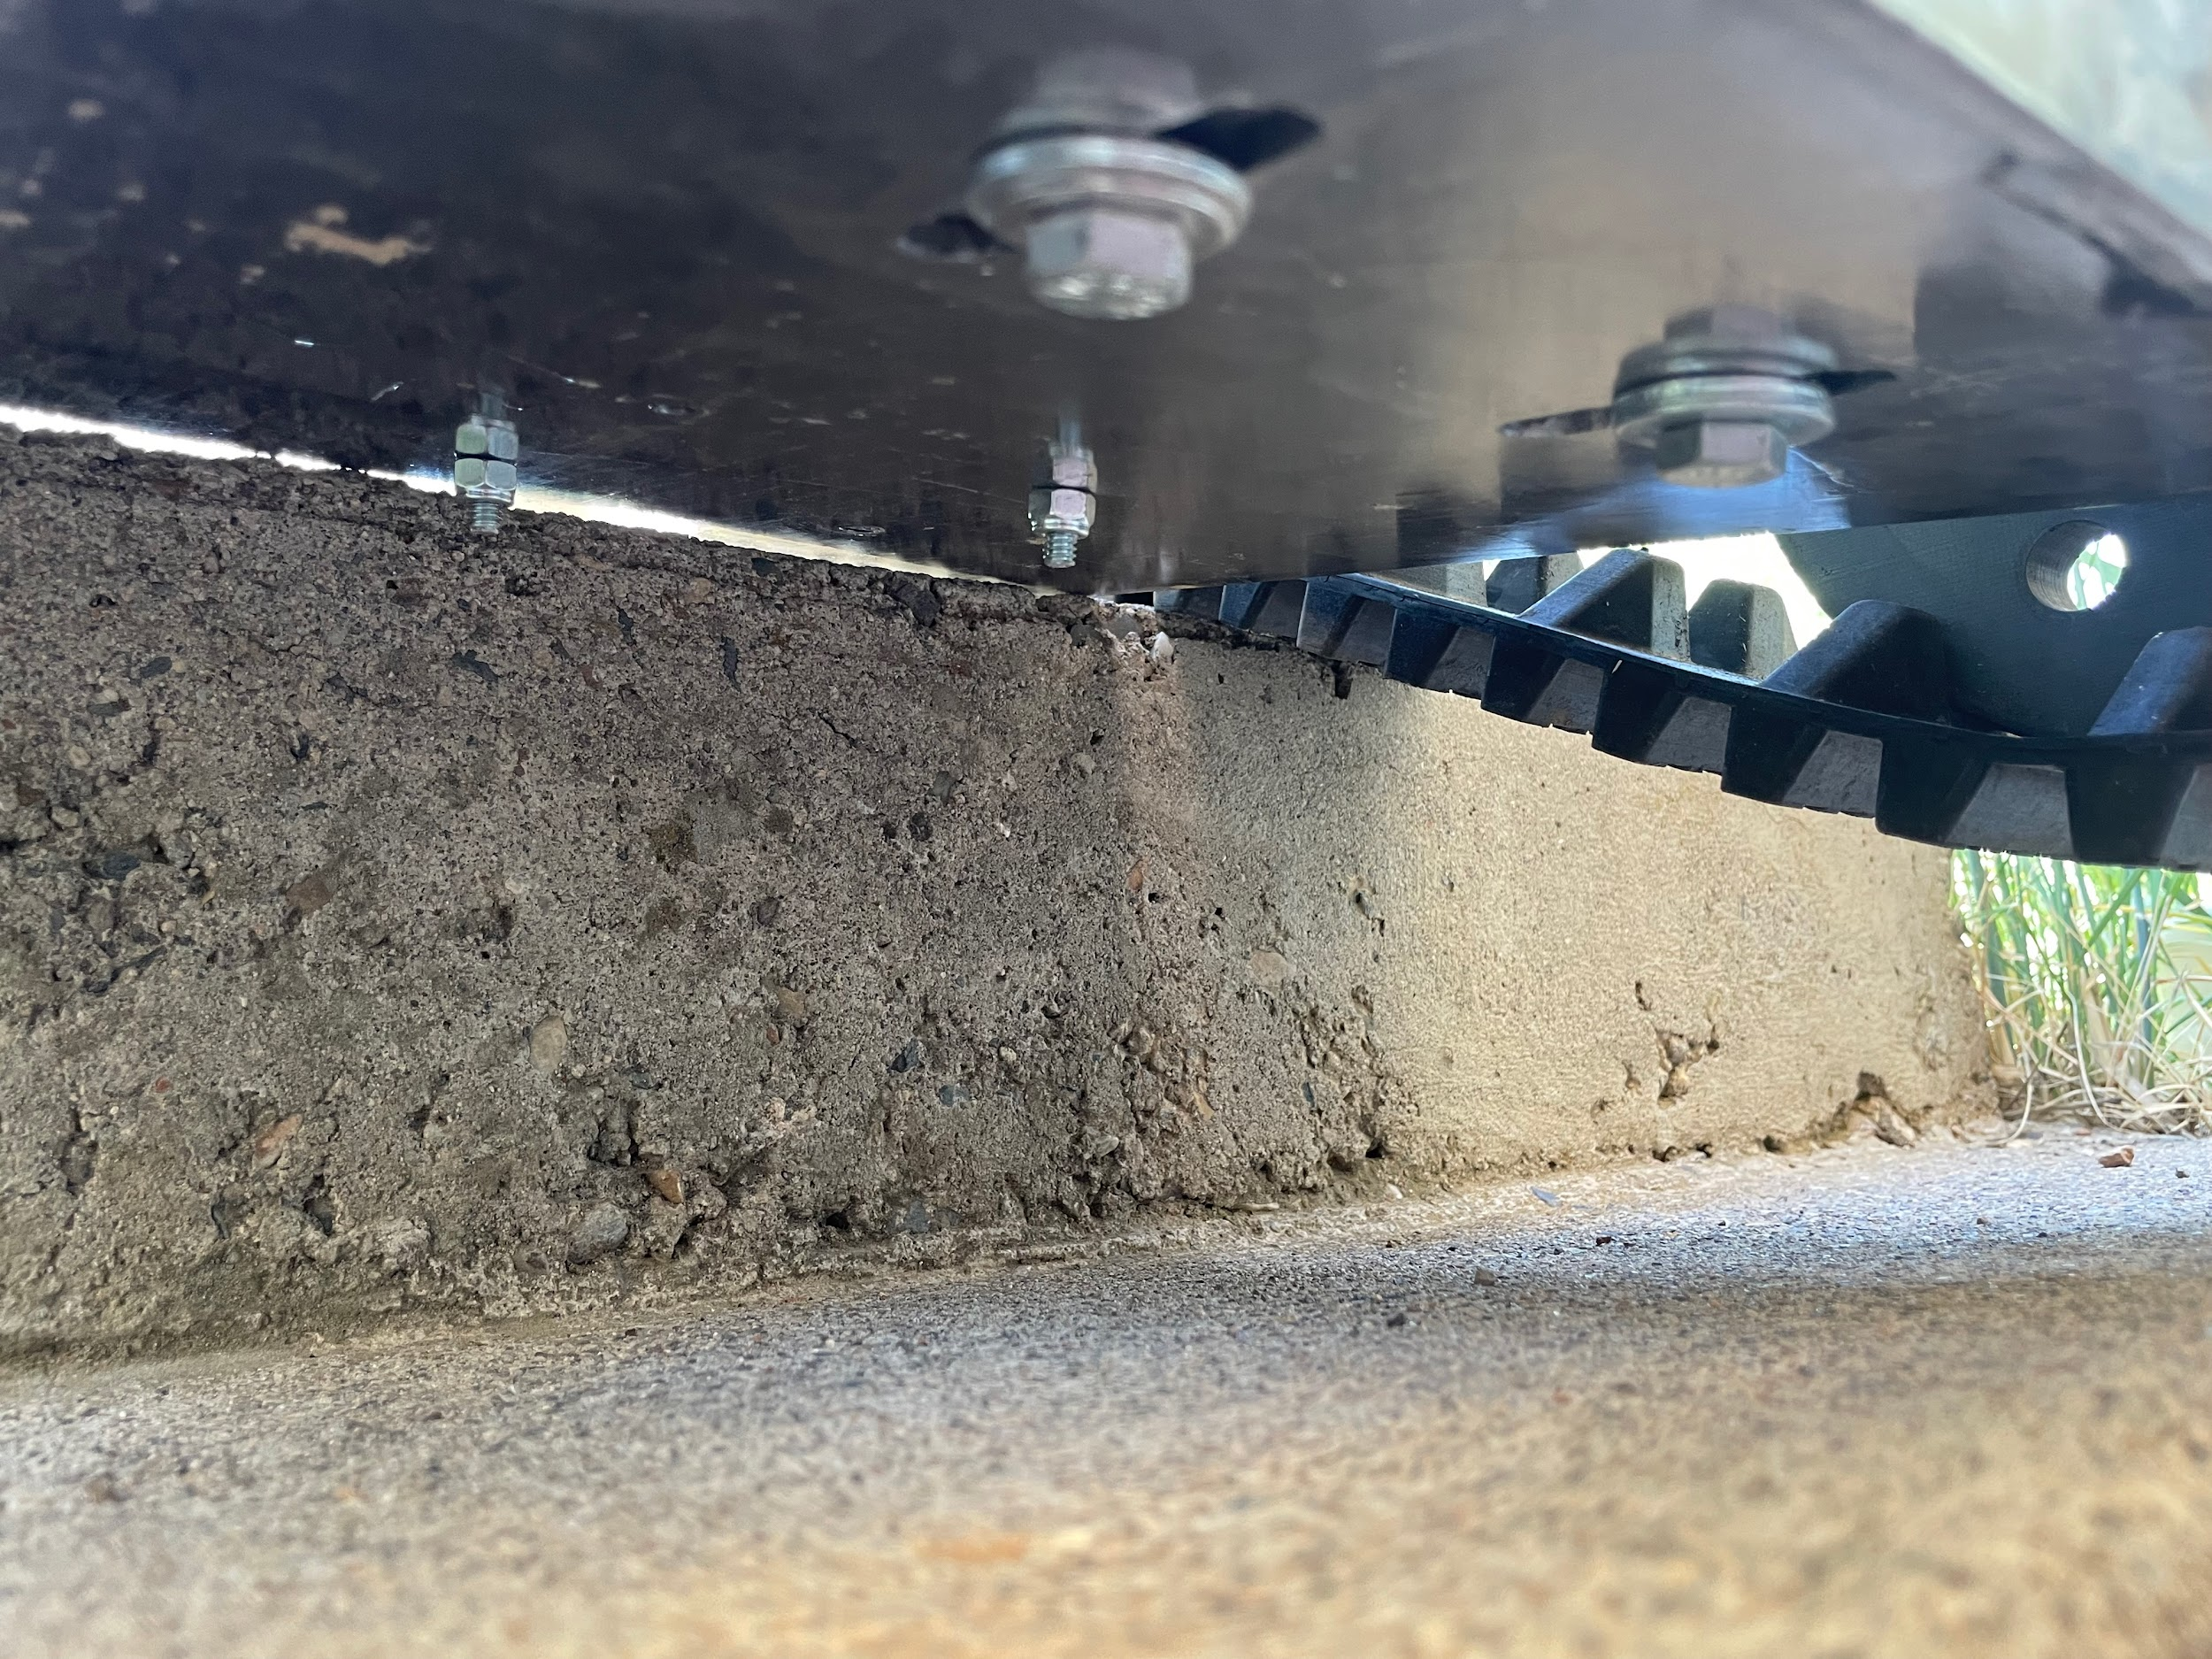
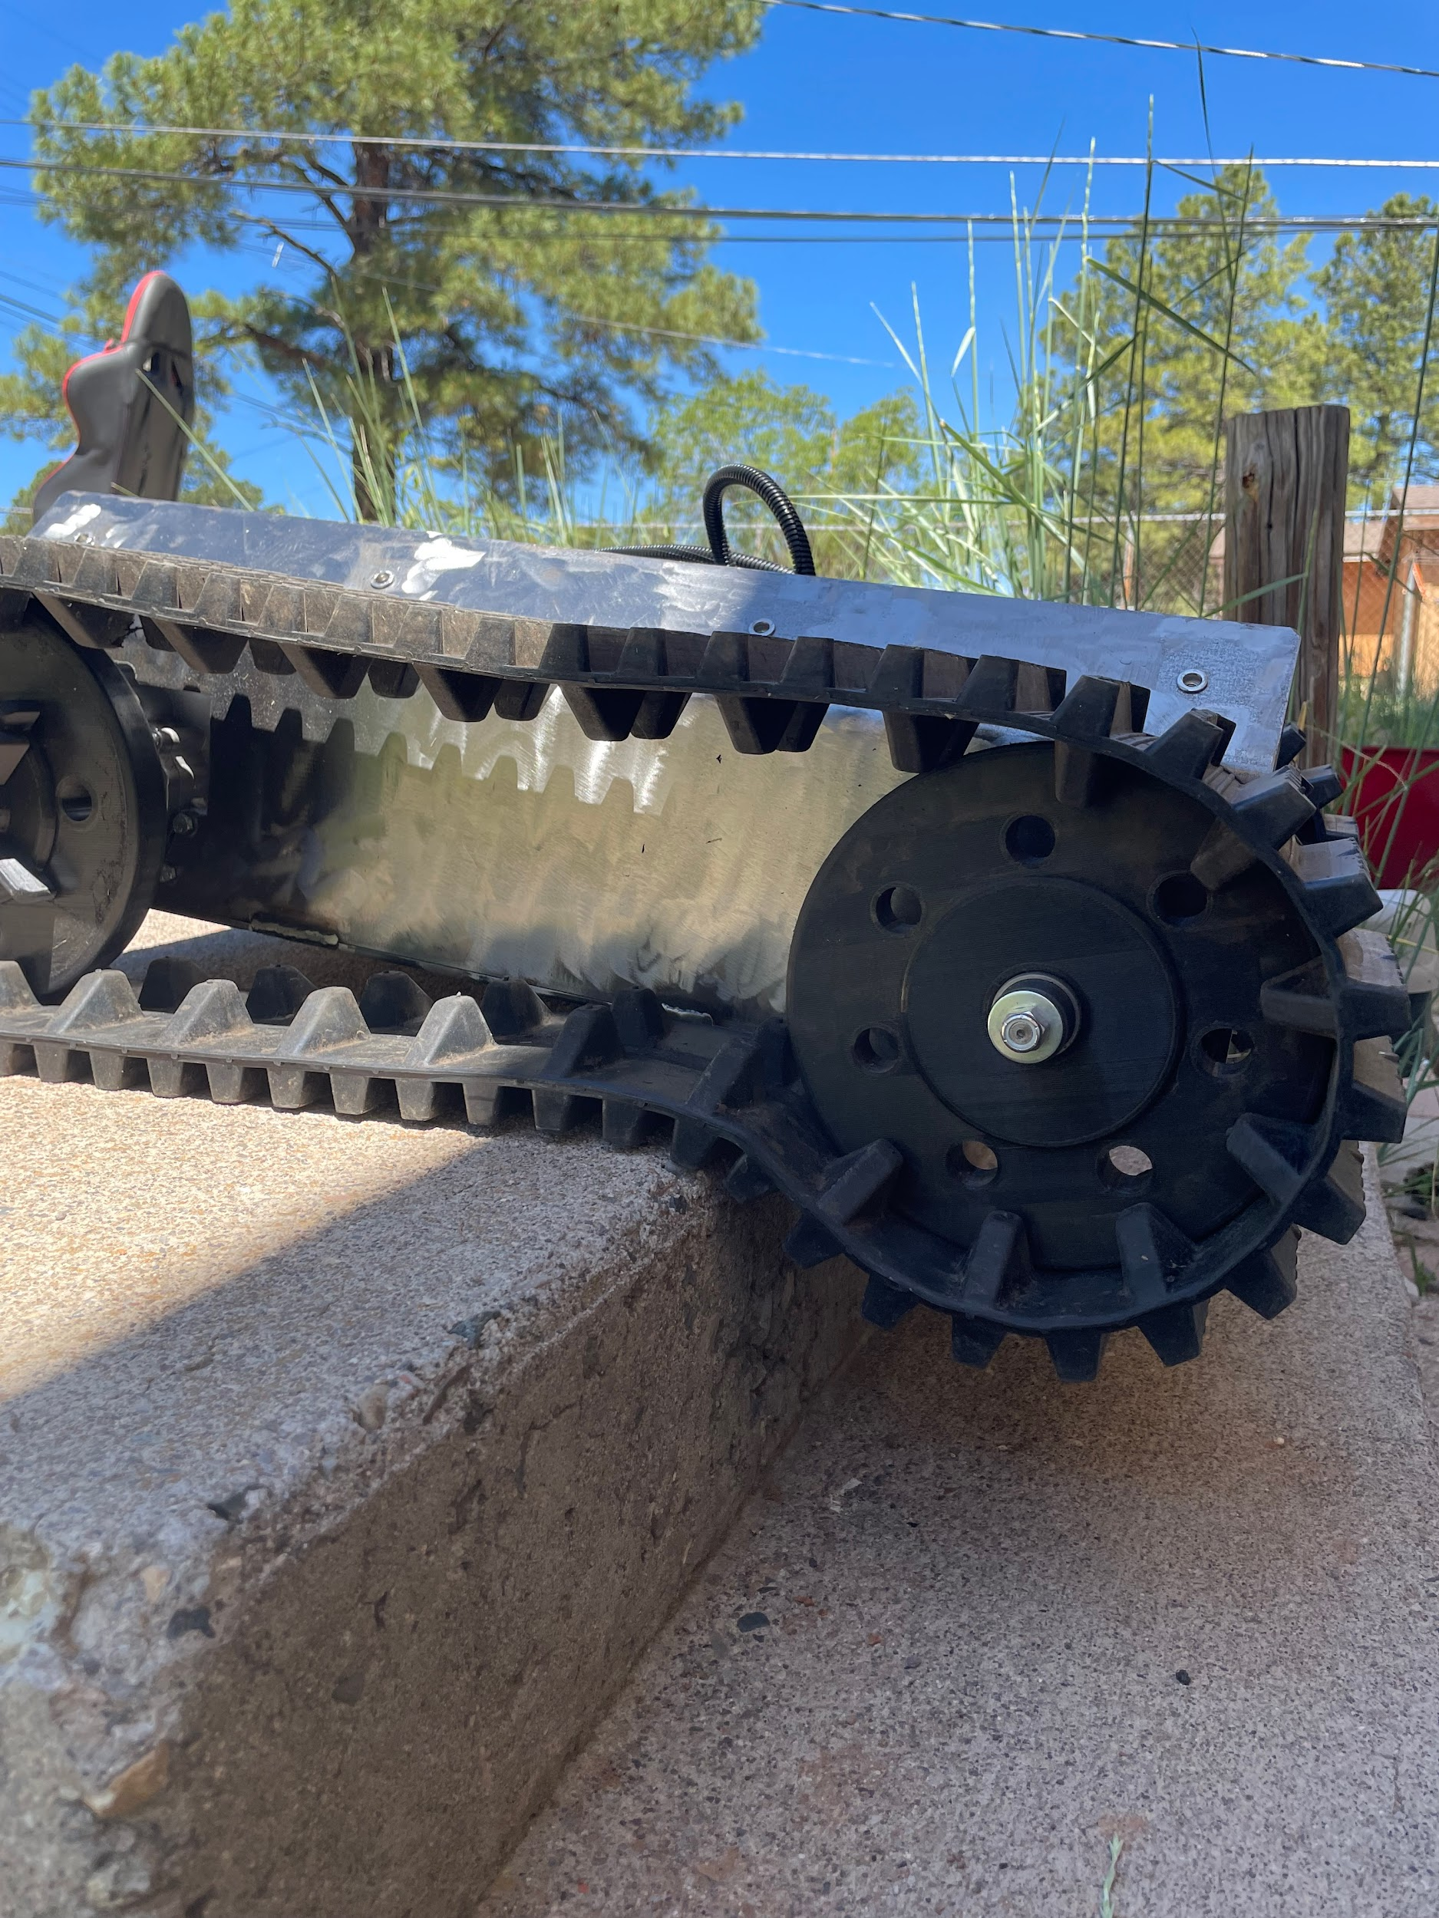
R.U.T. Mobility
R.U.T. Gets Stuck
Track Has No Tension
Figure 8: Obstacle Fail
Figure 9: Lack of Tension
Levi McAdams 08/01/23 VRCR

Slide 7
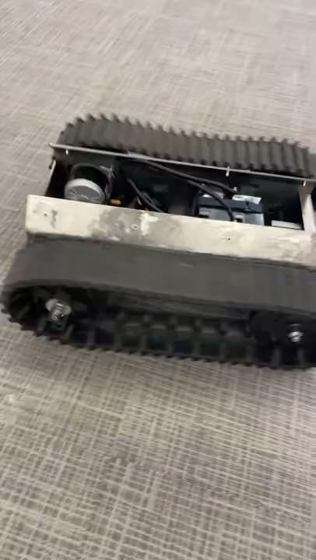
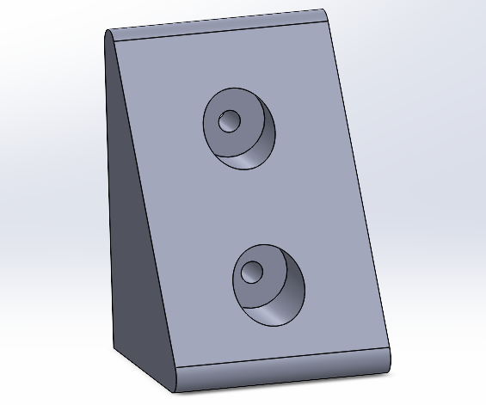
Turning Solution Prototype
Proposed Solutions:
Change from drive wheel to sprocket
Add teeth on the wheel
Increase tension
Solution Tested:
Results:
Figure 10: Wheel Stand-Off
Video 3: R.U.T. Can Turn
Levi McAdams 08/01/23 VRCR

Slide 8

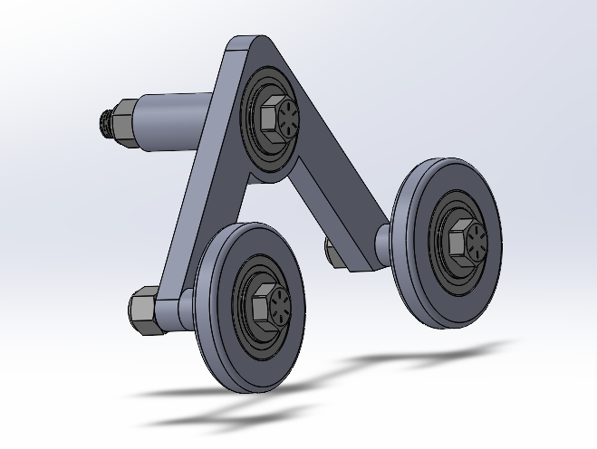
Obstacle Solution Prototype
Proposed Solution:
Tank track roller
Tensioners placed mid track
More Wheels
Prototype In Progress:
Solution Concept:
https://www.youtube.com/watch?v=8ZVAjZrDVtA&ab_channel=chobiglass
Video 4: Roller Movement
Figure 11: Roller Assembly
Levi McAdams 08/01/23 VRCR

Slide 9
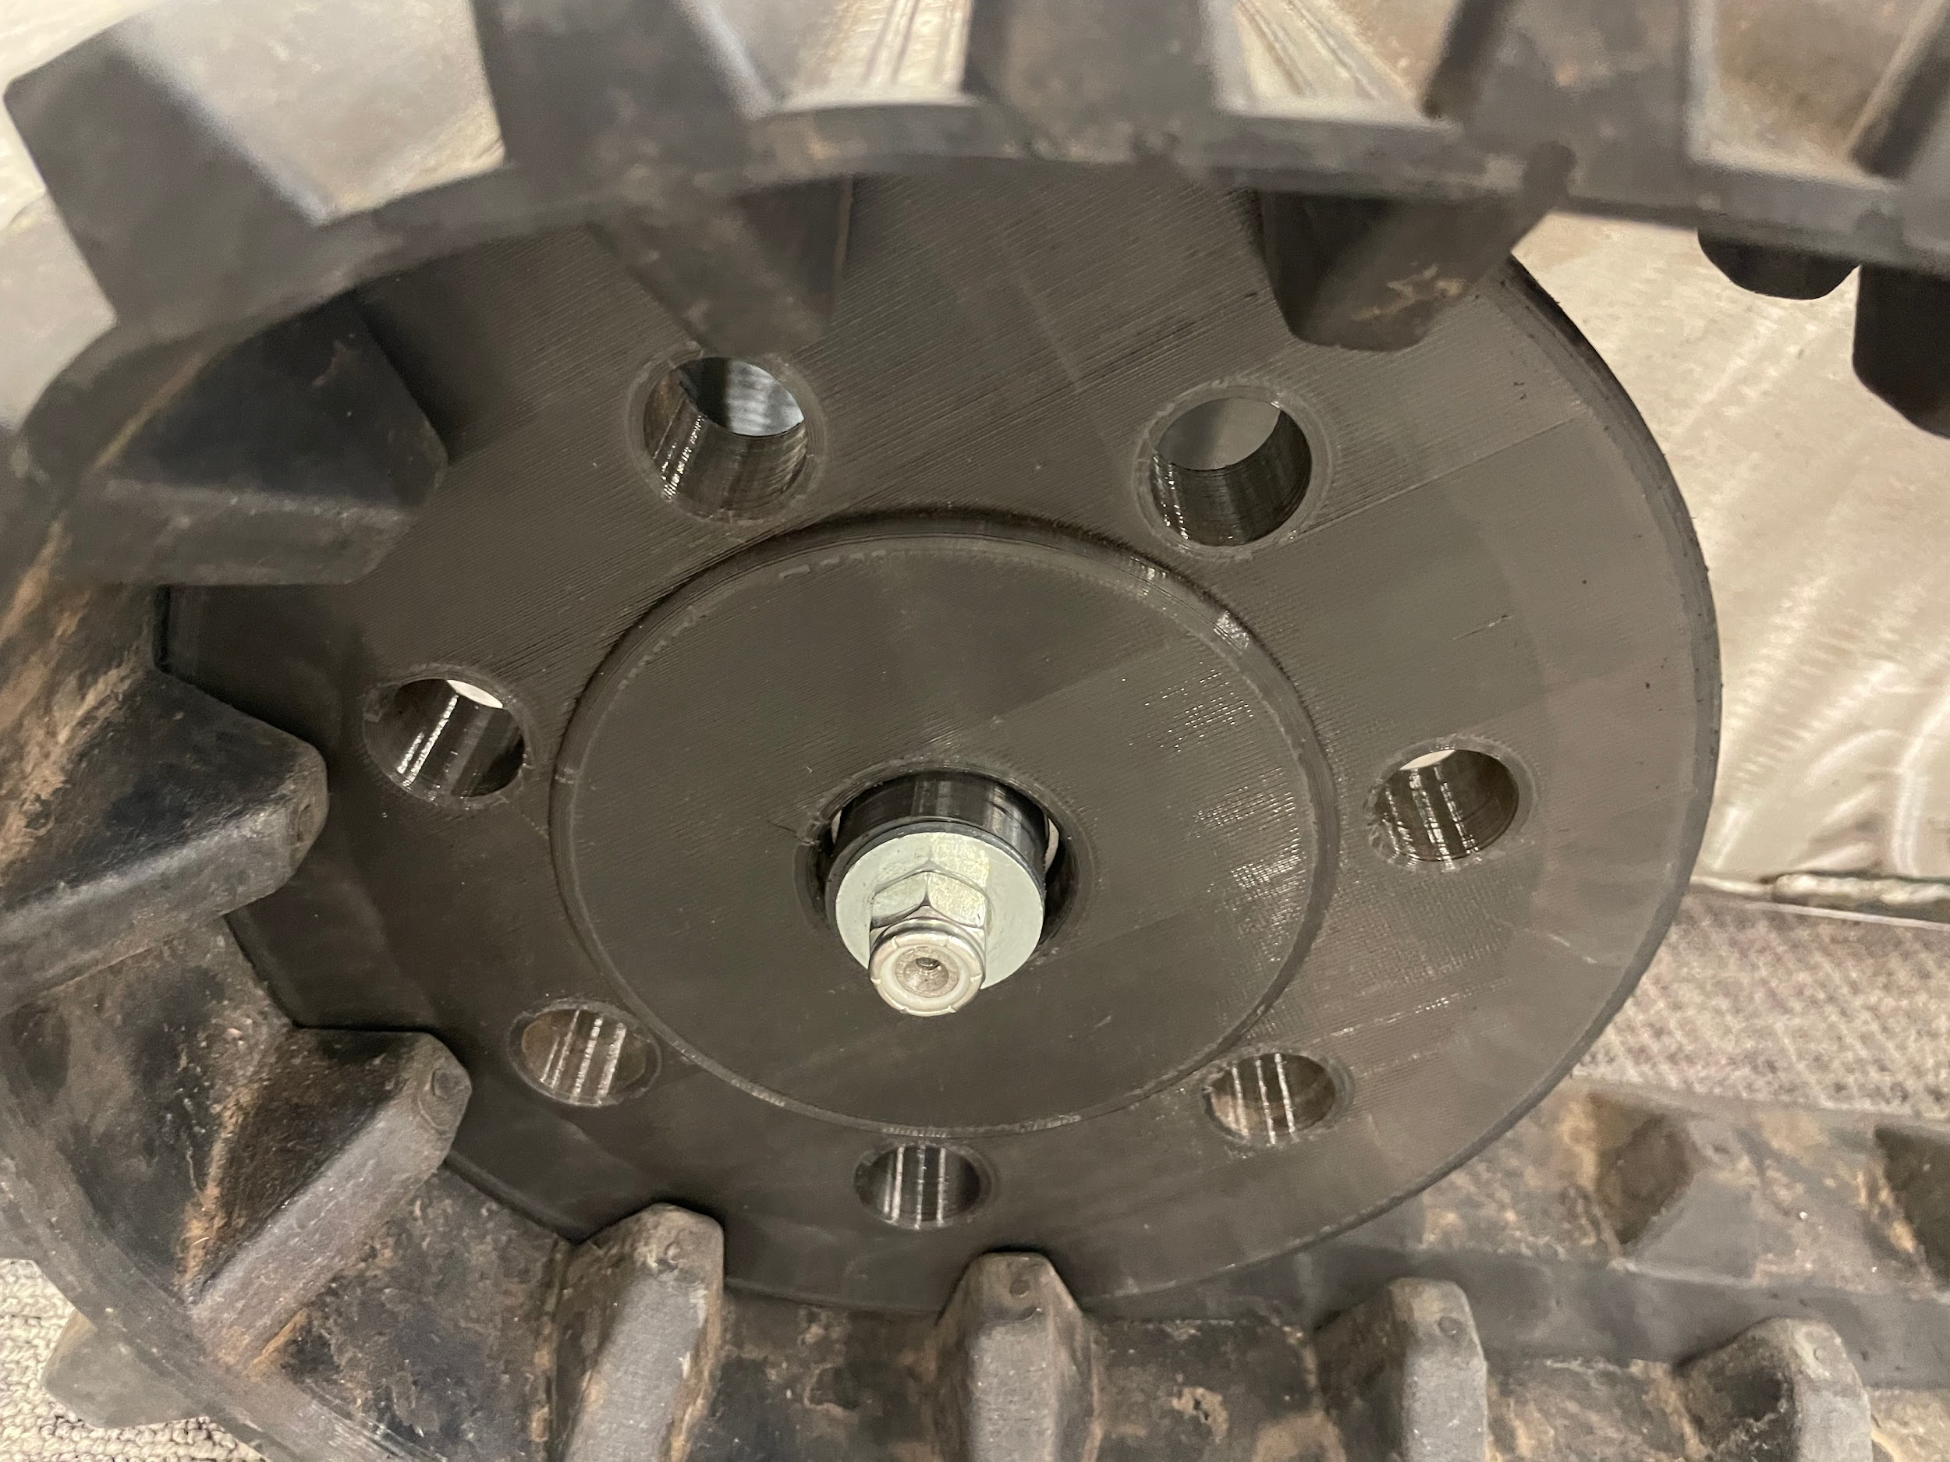
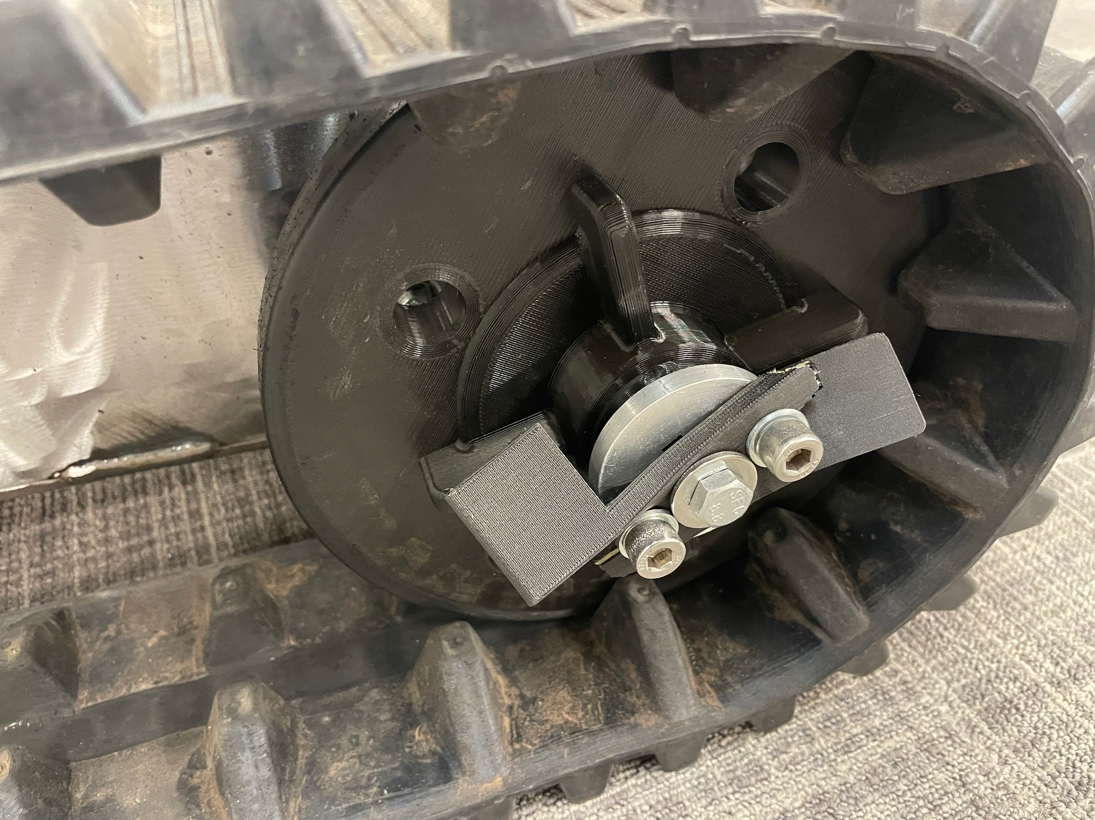
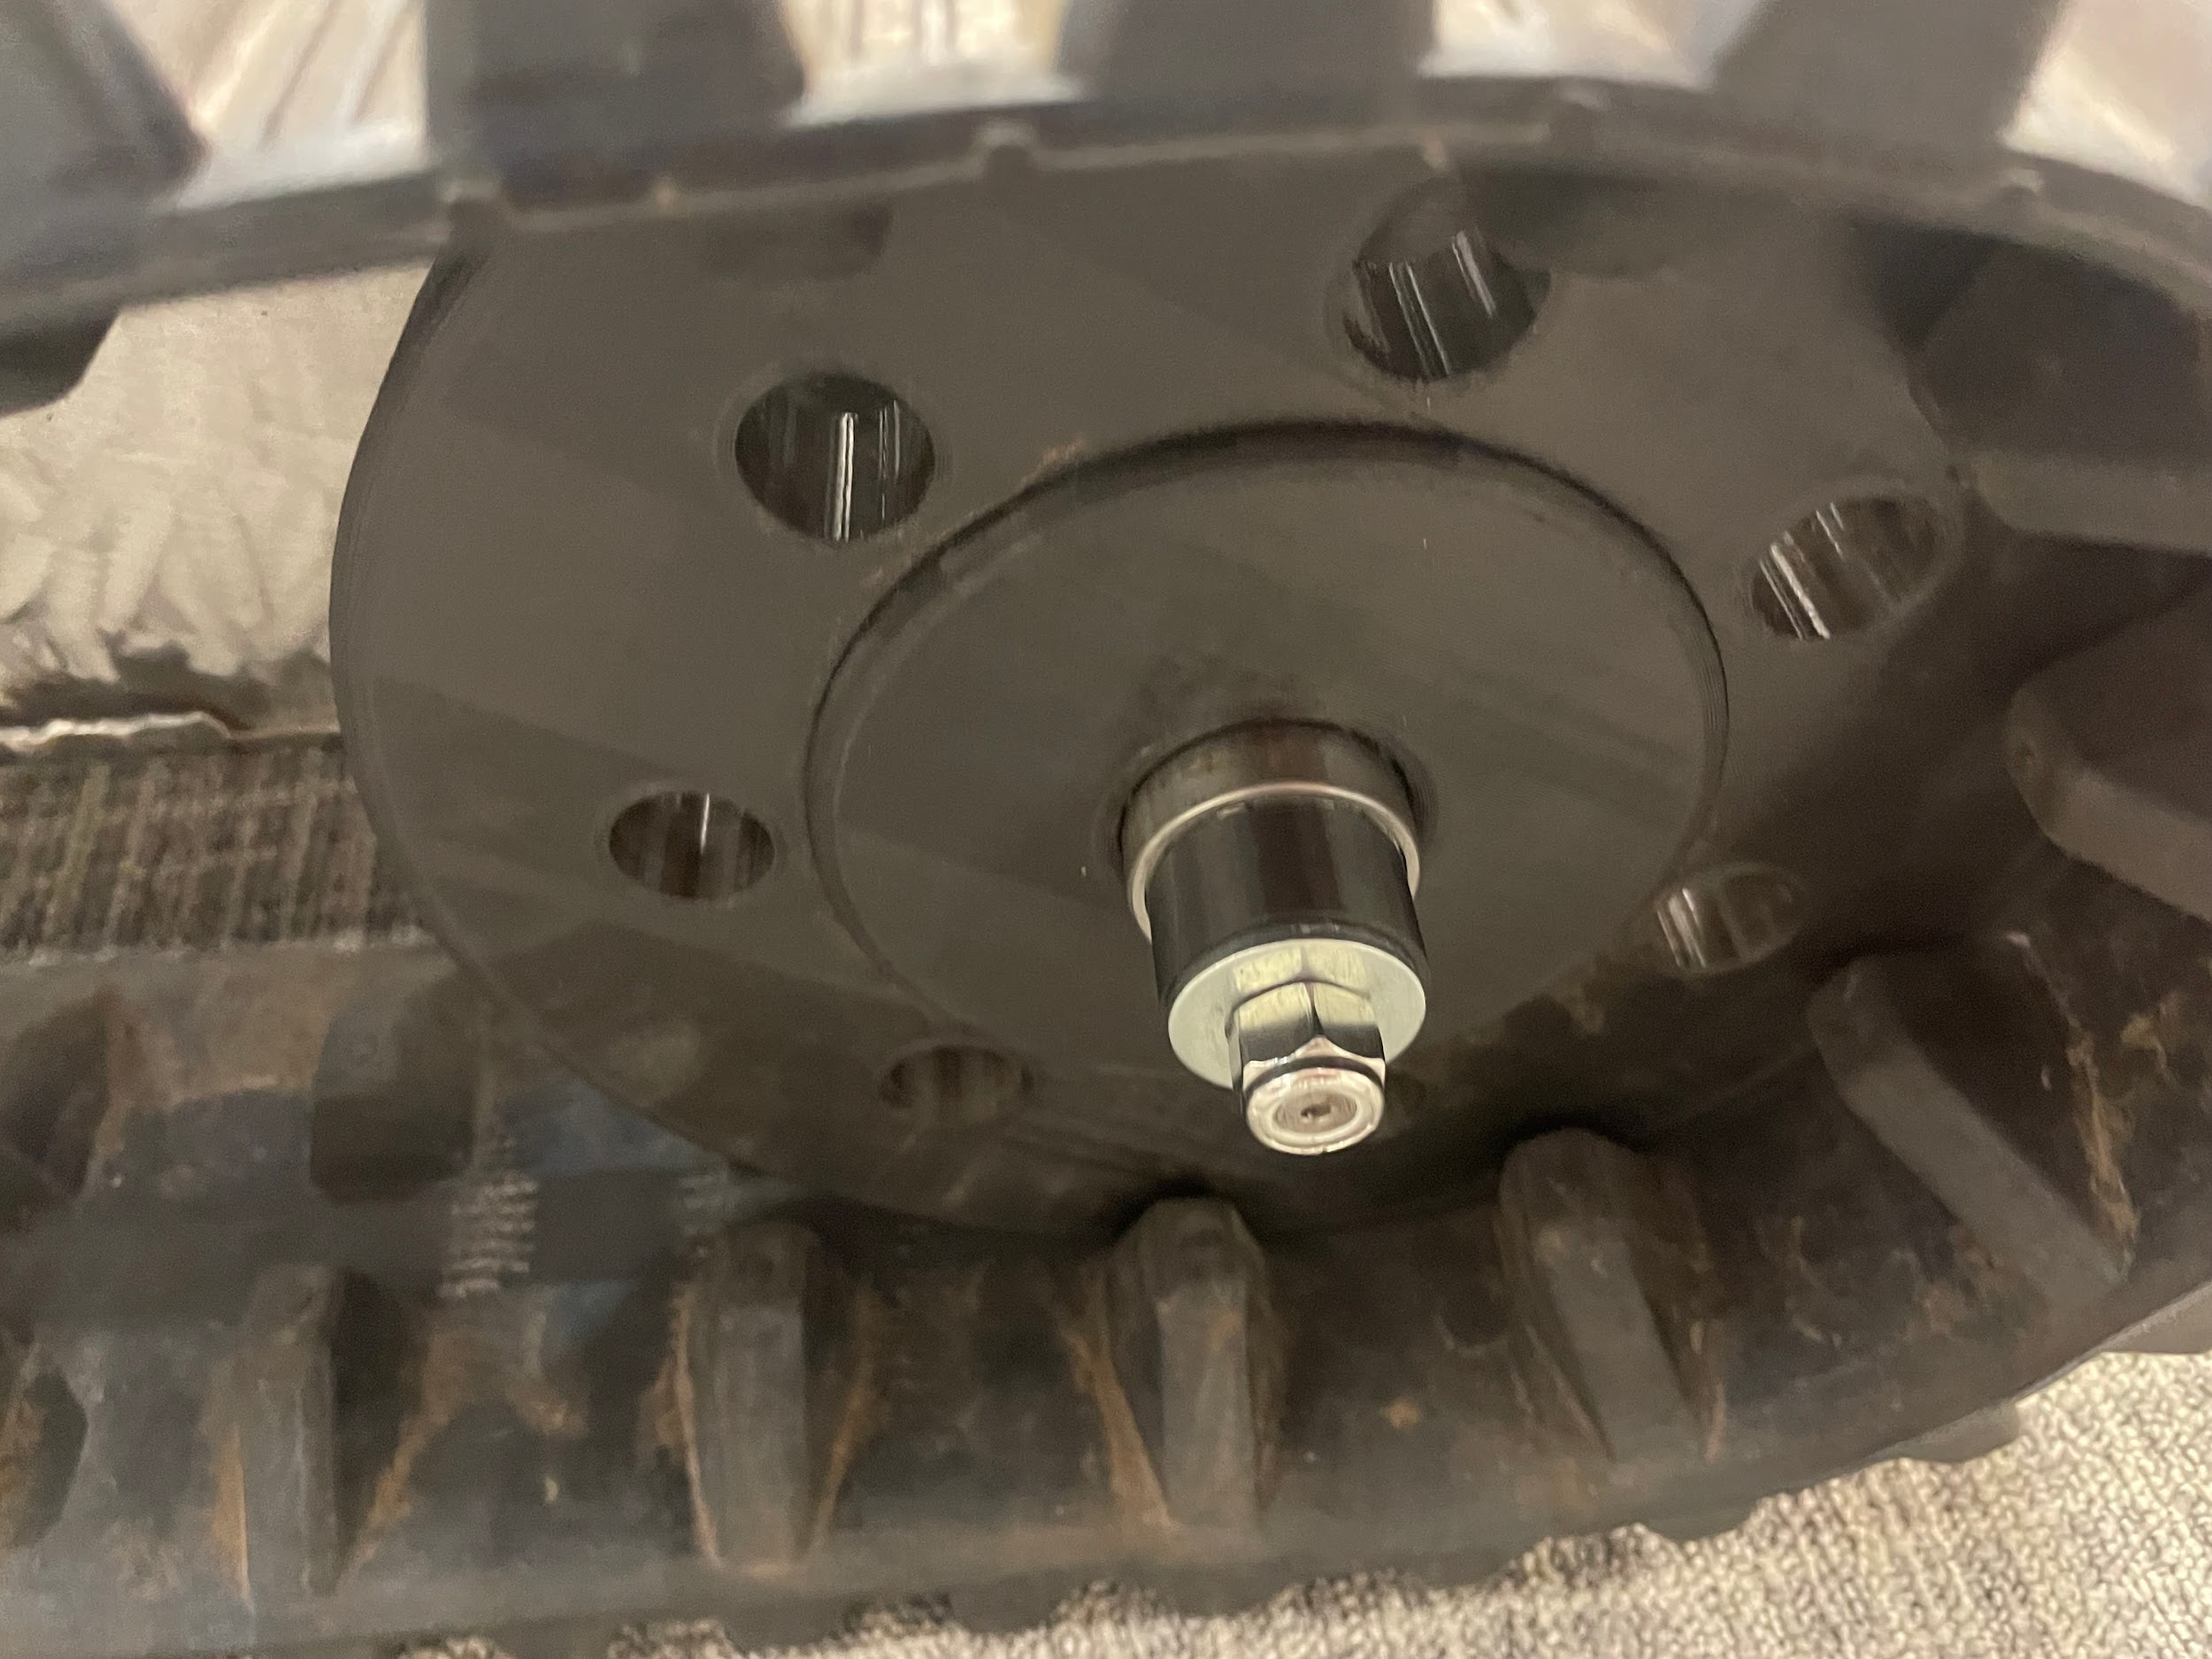
New Mobility Issues
Figure 12: Wheel Fell Off 1
Figure 14: Dog Clutch Failure
Action Plans:
Redesign entire drive wheel assembly
Redesign driven wheel mounting
Design a way to secure bearings (Snap Rings?)
Tyler Allen 08/01/23 VRCR
Figure 13: Wheel Fell Off 2

Slide 10
Camera Connection
Integration to Unity is a success
  Unity is a cross platform game development engine
Using source [2] I was able to link the Meta Quest 2 headset with Unity
  The software had VR compatibility, making it super easy to accommodate the very specific controls
Eric Hinds 08/01/23 VRCR

Slide 11
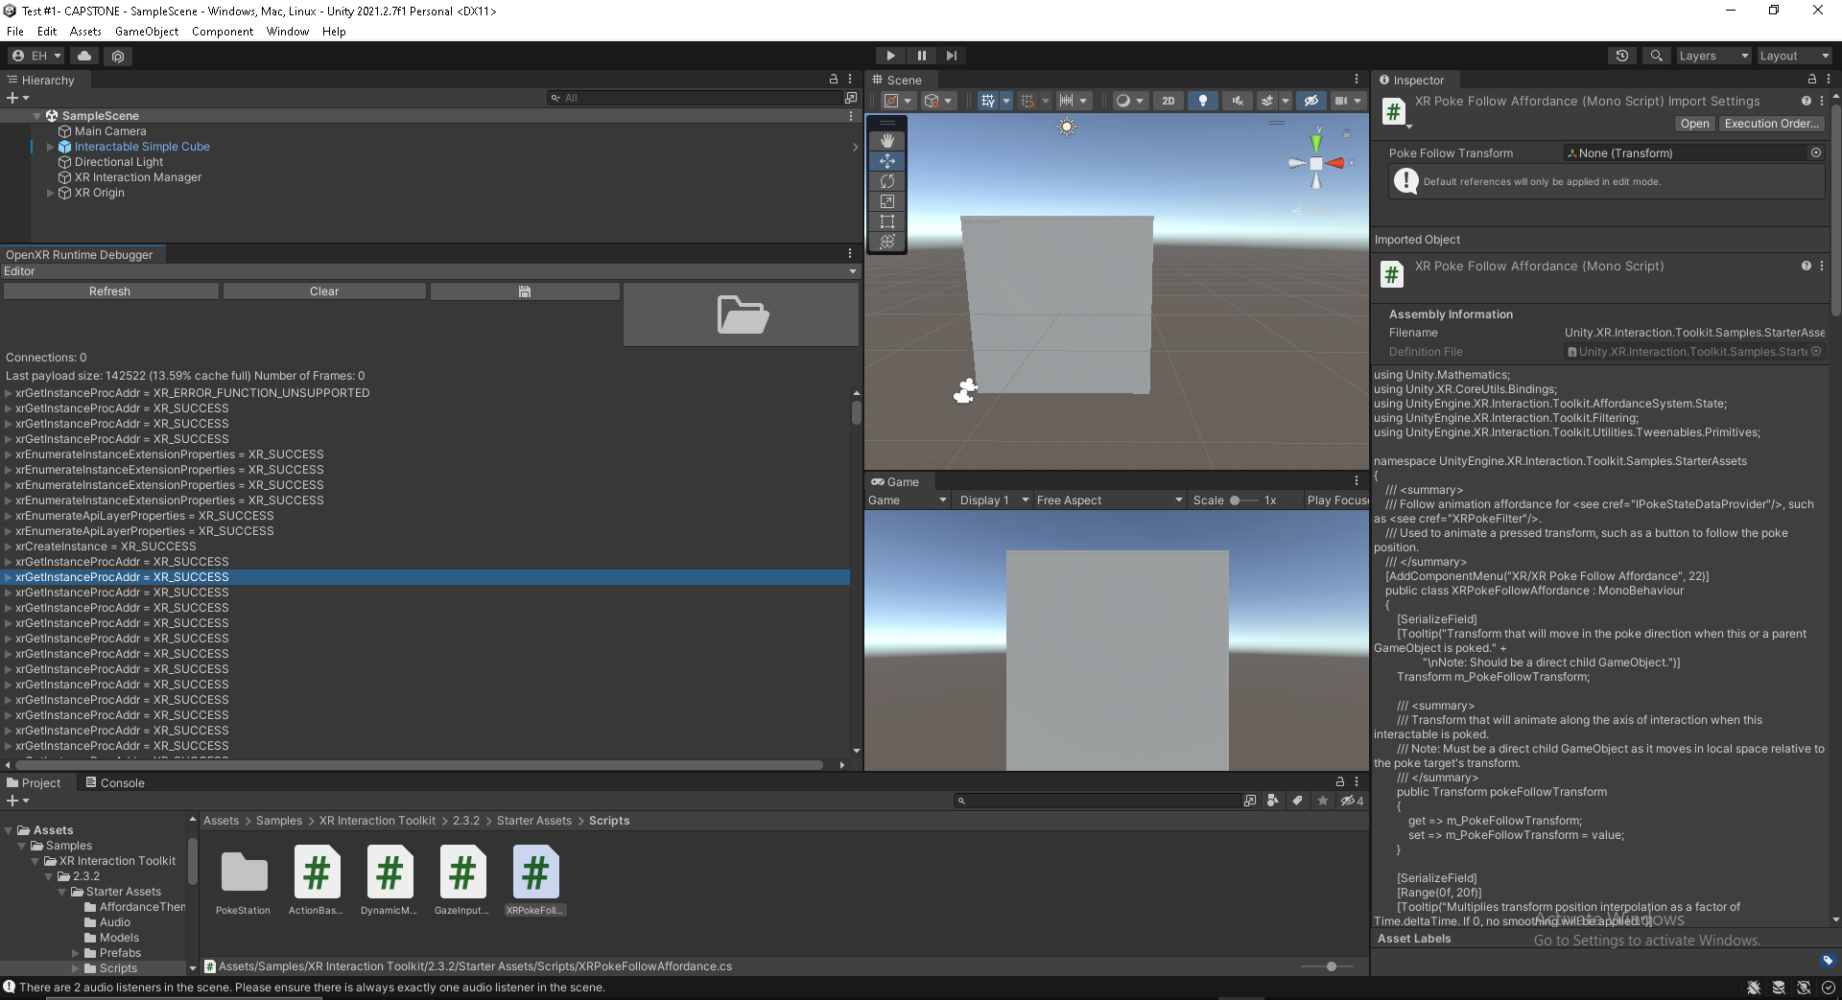
Camera Connection
Figured out how to find each components script name and input for future scripting
Using XR Interaction Debugger we can also interact with each inputs numerical value
  These values will be incredibly useful in the connection of VR Control
Eric Hinds 08/01/23 VRCR

Slide 12
Control System
Current Progress
Gain access from Unity to Arduino Board
Each motor can be controlled individually
Build up serial portal to allow instant reaction
Current Issues
Motor not stable under serial streaming, might cause arbitrary change under discontinuous streaming
Lifting strength in serial streaming is obviously lower than one-time input command
Alignment issues of the arm, can be fixed by adding phase
Zijian Song 08/01/23 VRCR

Slide 13
Control System
Future Plan
Refine coding to approach lifting strength closer to that under one-time command
Ease or solve the stability problem by adding protection codes or change algorithm
Access control base on position of VR controller
Zijian Song 08/01/23 VRCR

Slide 14
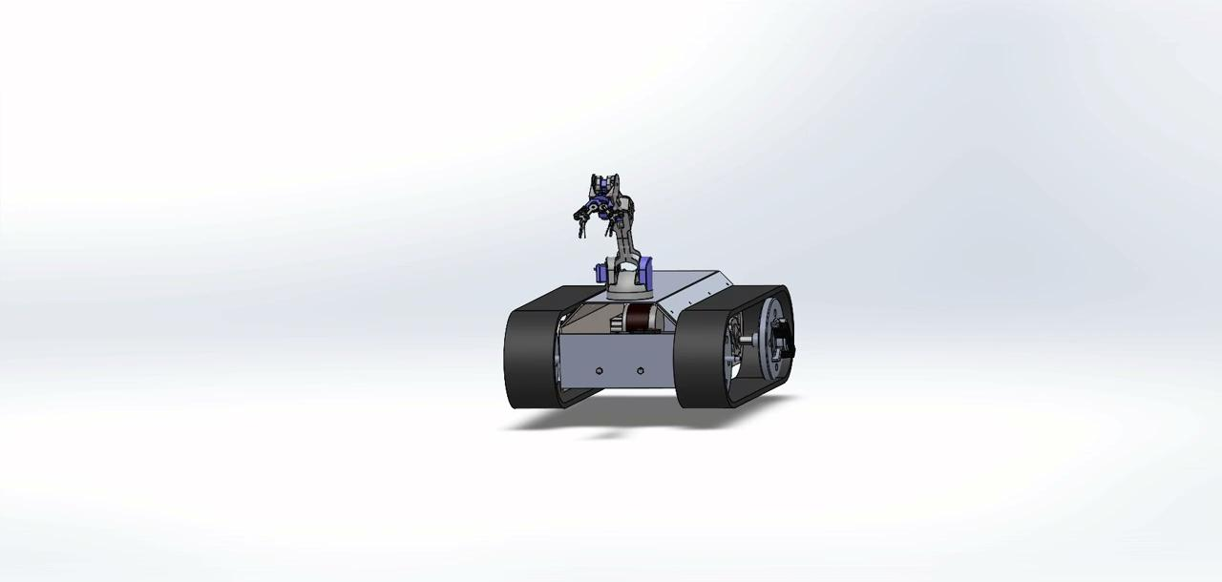
Full RTU assembly
Video 5: Full CAD assembly
Sam Torres 08/01/23 VRCR

Slide 15
Thank You

Slide 16
Questions?

Slide 17
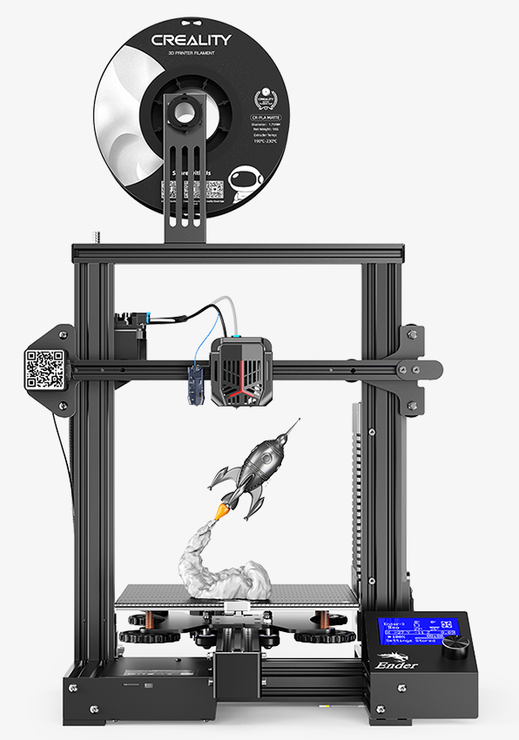
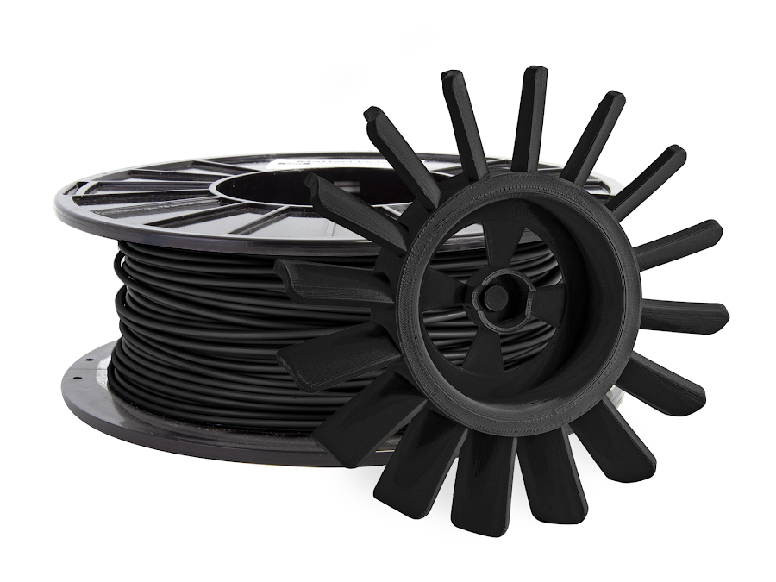
What printer and filament
Figure a: Ender 3 Neo
Figure b: PRO Series Tough PLA
https://www.creality.com/es/products/ender-3-neo-3d-printer
https://www.matterhackers.com/store/l/pro-series-tough-pla-filament/sk/MC2YDS13?rcode=PMAX_PMax1&gclid=CjwKCAjw-7OlBhB8EiwAnoOEkxyXEg4vYQF3NGen06LY0OCsxJ-SJxcaNLkwJDK87uTUskAVparaTxoCKJoQAvD_BwE

Slide 18
Potential Questions 2

Slide 19
Potential Questions 3

Slide 20
Potential Questions 4

Slide 21
Potential Questions 5

